Slide 1


GIT KSS
SESSION 2

Slide 2
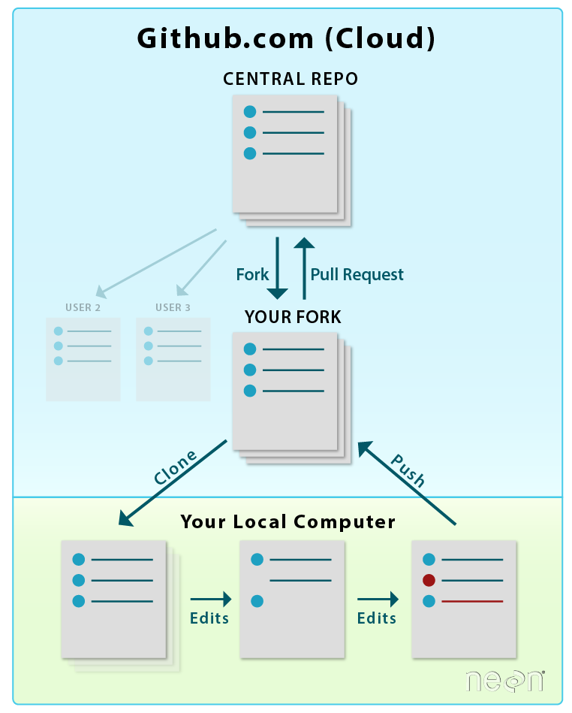
A GitHub fork is a copy of a repository (repo) that sits in your account rather than the account from which you forked the data from. This means that you can edit the contents of your forked repository without impacting the parent repo.
Once you do the changes in your forked repository you can make a pull request so that your changes are merged with the original repository.
What is a FORK?

Slide 3
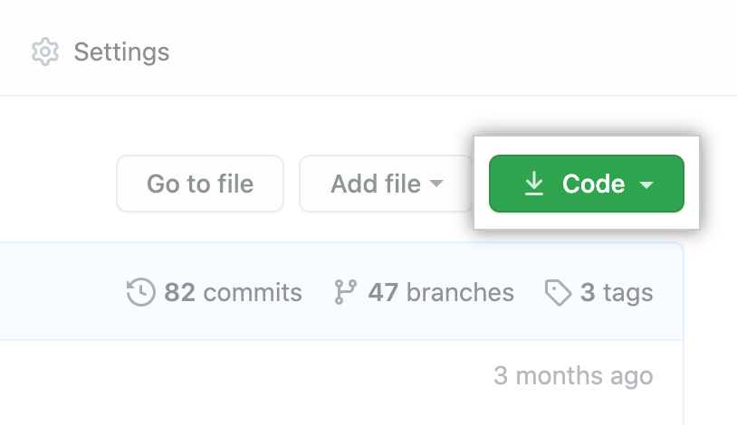
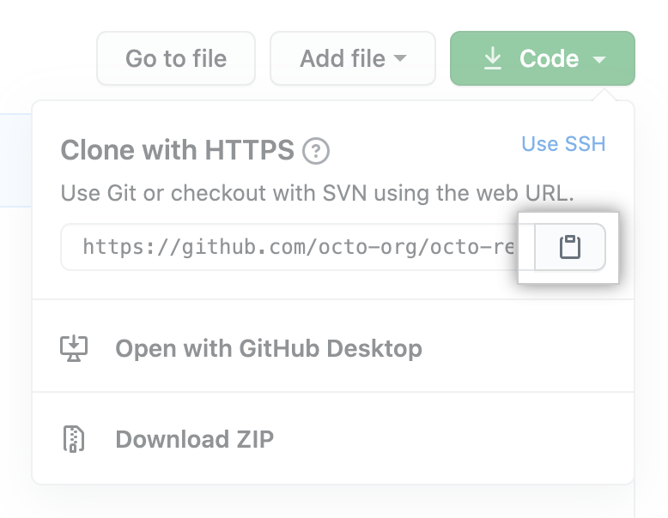
Cloning a Repository
If you want to get a copy of an existing Git repository — for example, a project you’d like to contribute to — the command you need is git clone.
This will create a full-fledged, local version of that Git repository in a folder specified by the user and the user can start working on the project.
COMMAND

Slide 4
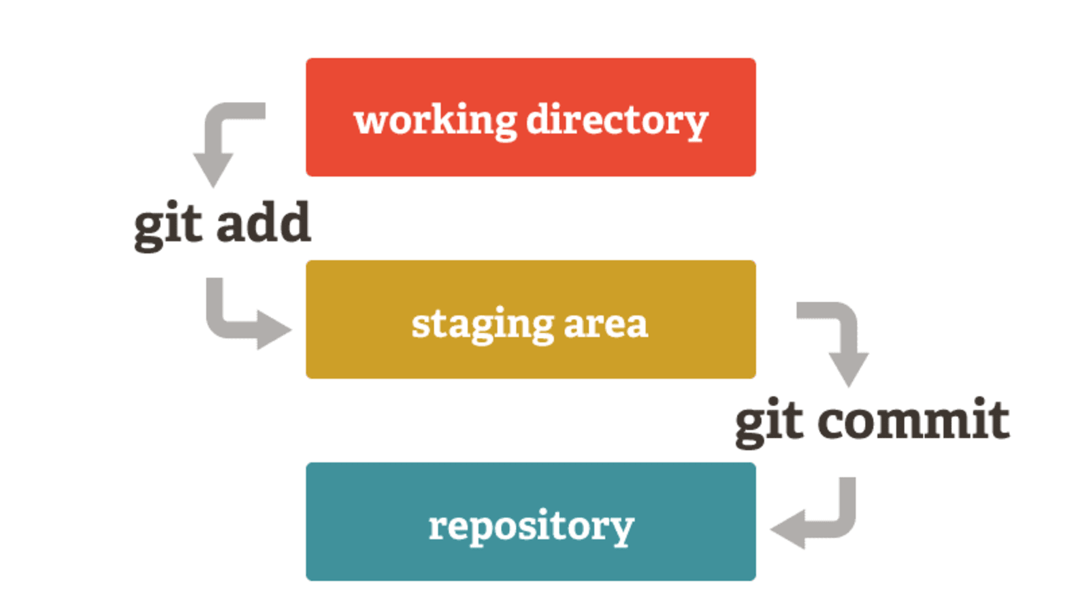
git add
Used to selectively stage changes
Two-layer approach
Keep all the changes you’ve made in your working directory
Update the remote upstream repo with only a handful of these changes
Used in combination with the `git status` command to list the state of the files in the directory and handpick updated files to be staged for the next commit.
The staging area allows gathering all the connected changes into highly focused snapshots.

Slide 5
git commit
git commit creates a commit, which is like a SNAPSHOT of your repository.
These commits are snapshots of your entire repository at specific times.
Commits include lots of metadata in addition to the contents and message, like the author, timestamp, and more.
Options – we use a -m flag to add a message to the commit.
Eg. – git commit -m “sample-commit”
NOTE : before committing the changes one has to stage them using git add . or git add filename .
Notes:
Run these commands and show them.

Slide 6
git log
Git log is a utility tool to review and read a history of everything that happens to a repository. Multiple options can be used with a git log to make history more specific.Generally, the git log is a record of commits.
A git log contains the following data:
Commit hash : It is a 40 character checksum data generated by SHA (Secure Hash Algorithm) algorithm. It is a unique number.
Commit Author metadata: The information of authors such as author name and email.
Commit Date metadata: It's a date timestamp for the time of the commit.
Commit title/message: It is the overview of the commit given in the commit message.
Options – there are many flags we can use with it. For example --online, --graph, --author “author's name” and many more.
Notes:
We have to run these log with different options and flags to make them understand its difference.

Slide 7
git diff
Diffing is a function that takes two input data sets and outputs the changes between them. git diff is a multi-use Git command that when executed runs a diff function on Git data sources. These data sources can be commits, branches, files and more. This document will discuss common invocations of git diff and diffing work flow patterns. The git diff command is often used along with git status and git log to analyze the current state of a Git repo.
Some usecases –
git diff <commit1-sha> <commit2-sha>
git diff <branch 1> < branch 2>
NOTE : not used much frequently, just an utility command-line tool.

Slide 8
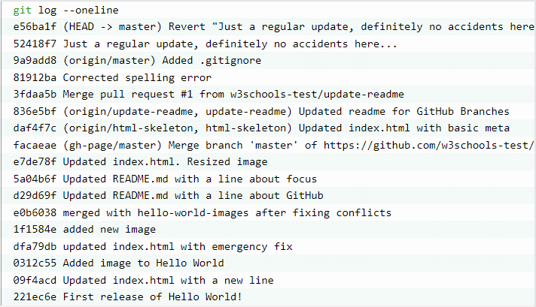
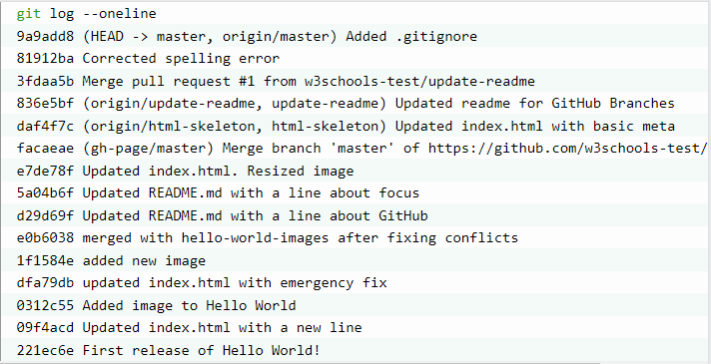
git reset
git reset is the command we use when we want to move the repository back to a previous commit, discarding any changes made after that commit.
git reset 9a9add8

Slide 9
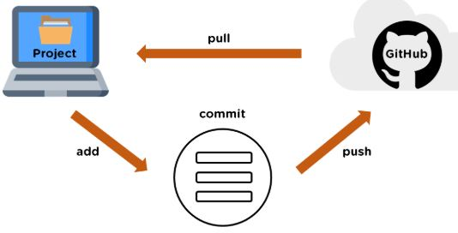
git push
The git push command is used to upload local repository content to a remote repository.

Slide 10
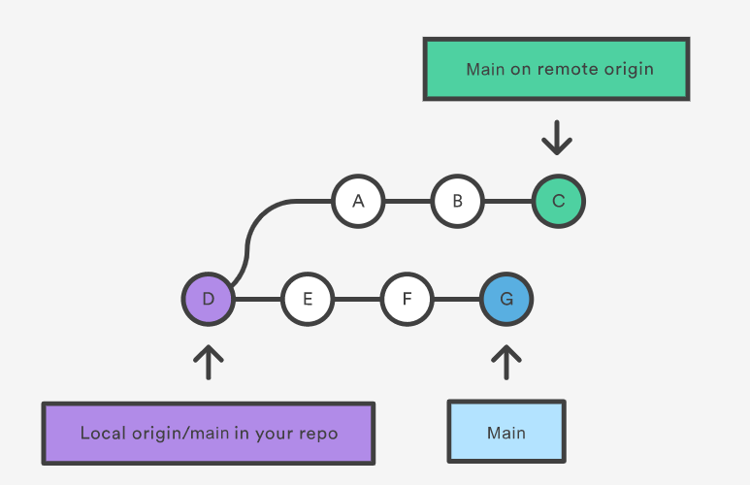
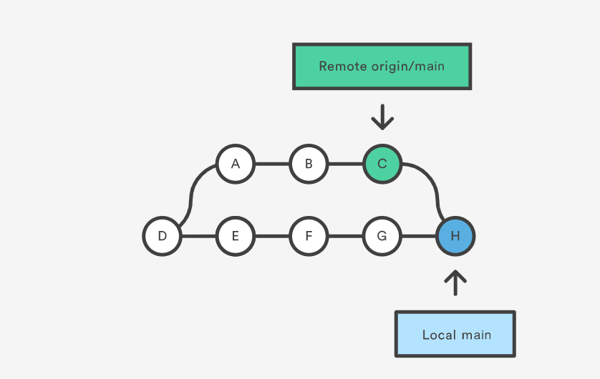
git pull
The git pull command is used to fetch and download content from a remote repository and immediately update the local repository to match that content.
It’s actually a git fetch command followed by a git merge.

Slide 11
git revert
Can be considered an UNDO type command
Instead of removing the commit from the project history, it figures out how to invert the changes introduced by the commit and appends a new commit with the resulting inverse content.
Prevents Git from losing history, which is important for the integrity of your revision history and for reliable collaboration
Useful, if you’re tracking down a bug and find that it was introduced by a single commit. Instead of manually going in, fixing it, and committing a new snapshot, you can use git revert to automatically do all of this for you.
`git revert HEAD~3`
Revert the changes specified by the fourth last commit in HEAD and create a new commit with the reverted changes.

Slide 12
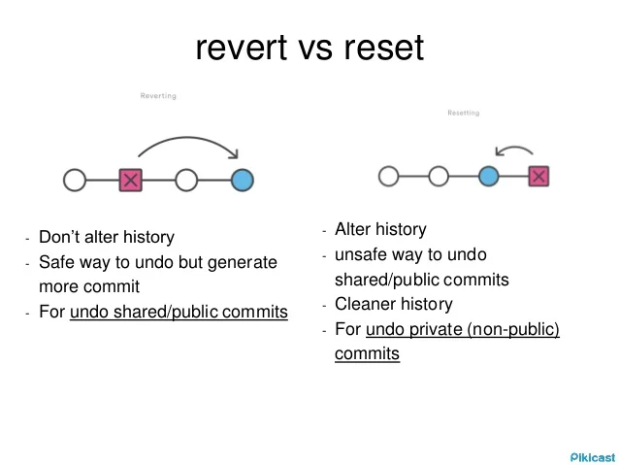

Slide 13
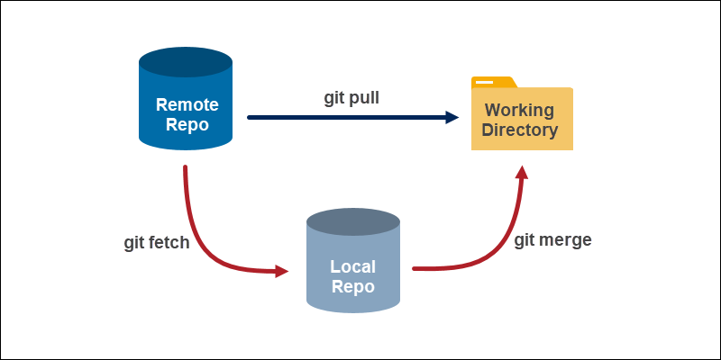
git fetch
The git fetch command downloads commits, files, and refs (all the changes) from a remote repository into your local repo.
The difference between fetch and pull
When downloading content from a remote repo, git pull and git fetch commands are available to accomplish the task.
You can consider git fetch the 'safe' version of the two commands. It will download the remote content but not update your local repo's working state, leaving your current work intact. git pull is the more aggressive alternative; it will download the remote content for the active local branch and immediately execute git merge to create a merge commit for the new remote content.

Slide 14
BRANCHES IN GIT

Slide 15
CONTENTS
What is a Branch ?
How branching works?
Why do we need branches?
Create a branch
Checkout branch

Slide 16

WHAT IS A BRANCH?
A branch is like an isolated environment where developers individually work and experiment new and different features, without messing up the master branch (main codebase).
Git branches are effectively a pointer to a snapshot of your changes.
Once you have tested the feature or fixed your bug, you can merge the branch into the master branch and then delete the branch. It also gives you an option to clean up your commit history in the branch before merging.

Slide 17
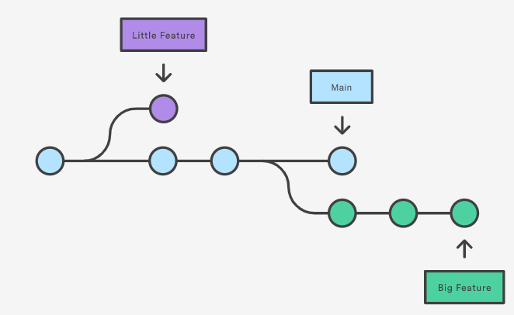
How branching works in Git?
Notes:
In this diagram, the blue line indicates the master branch and the circles represent the commits. Say 2 developers want to work on 2 different features simultaneously. To do so, they create a branch which is essentially an extrapolation of the master branch in an isolated environment. One of them starts working on the “little feature” (purple) after checking out the first commit to the master branch and the other works on “big feature” after checking out the 3rd commit to the master.

Slide 18
Need for branching
By isolating from the actual code base, a developer is free to experiment and play around with the code to try out new features and fix bugs.
Facilitates effective code collaboration which is extremely important, especially in large scale projects.
Better code maintenance, helps keep the master branch clean and tidy.

Slide 19
THANK YOU

